Slide 1


MSDS 6306: Doing Data Science - Case Study 01 US Craft Beers and Breweries Analysis
By
-Sowmya Mani
-Migot Ndede

Slide 2


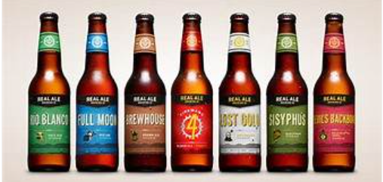
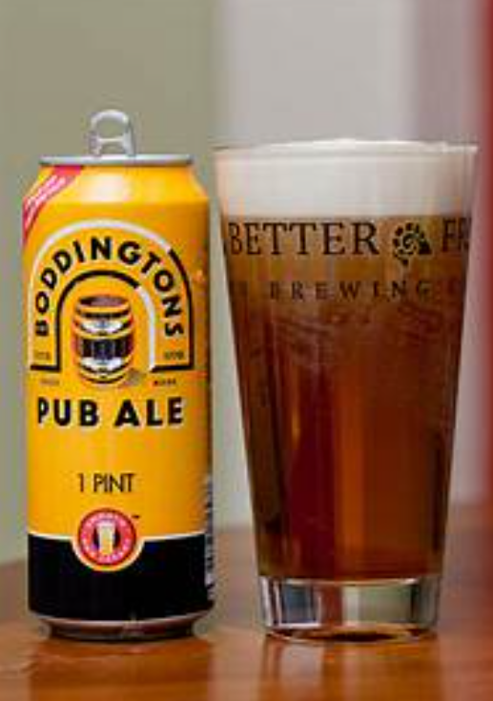
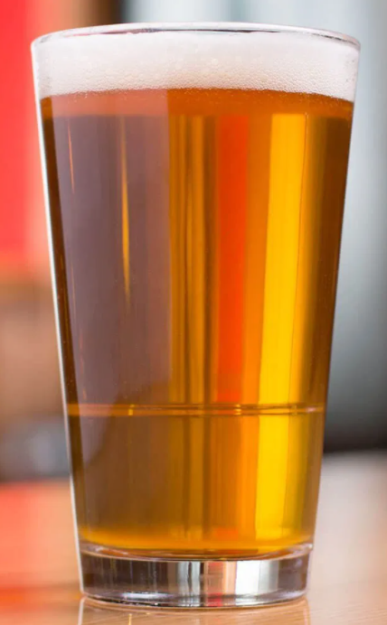
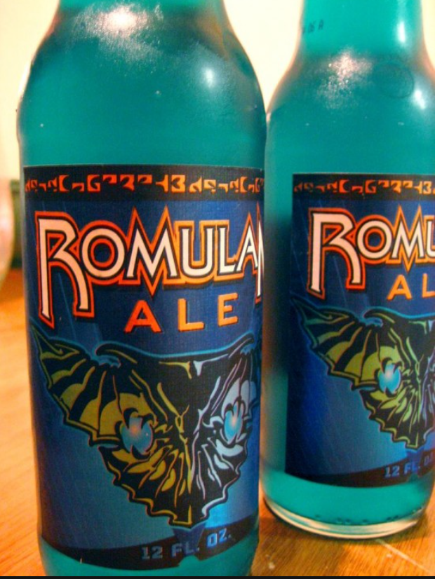
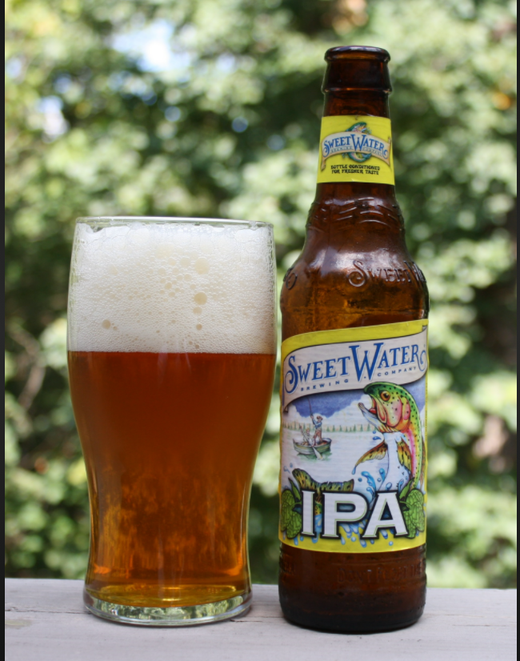
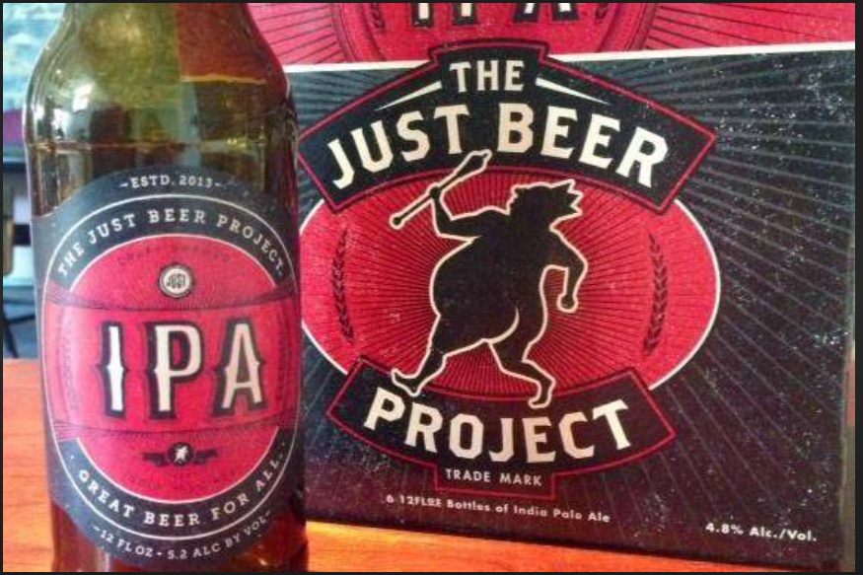
Introduction
This Case Study is about the Market Analysis of Beers and Breweries within the states of US
Goal of our team is to
Analyze Beer market and present our findings
Analyze Beer style especially IPA and ALE
Peek into the IBU and ABV differences
Make the predictions and conclusions to help Budweiser make a decision
This is an observational study on the different breweries and beer styles across US

Slide 3
Dataset Analysis
Dataset used for this case study analysis consists of
Beers - with 2410 Craft Beers along with their details about:
Name: Name of the beer
Beer_ID: Unique identifier of the beer
ABV: Alcohol by volume of the beer
IBU: International Bitterness Units of the beer
Brewery_ID: Brewery id associated with the beer
Style: Style of the beer
Ounces: Ounces of beer
Breweries - with 558 Breweries across US along with their details about
Name: Name of the brewery
City: City where the brewery is located
State: U.S. State where the brewery is located
Brew_ID: Unique identifier of the brewery

Slide 4
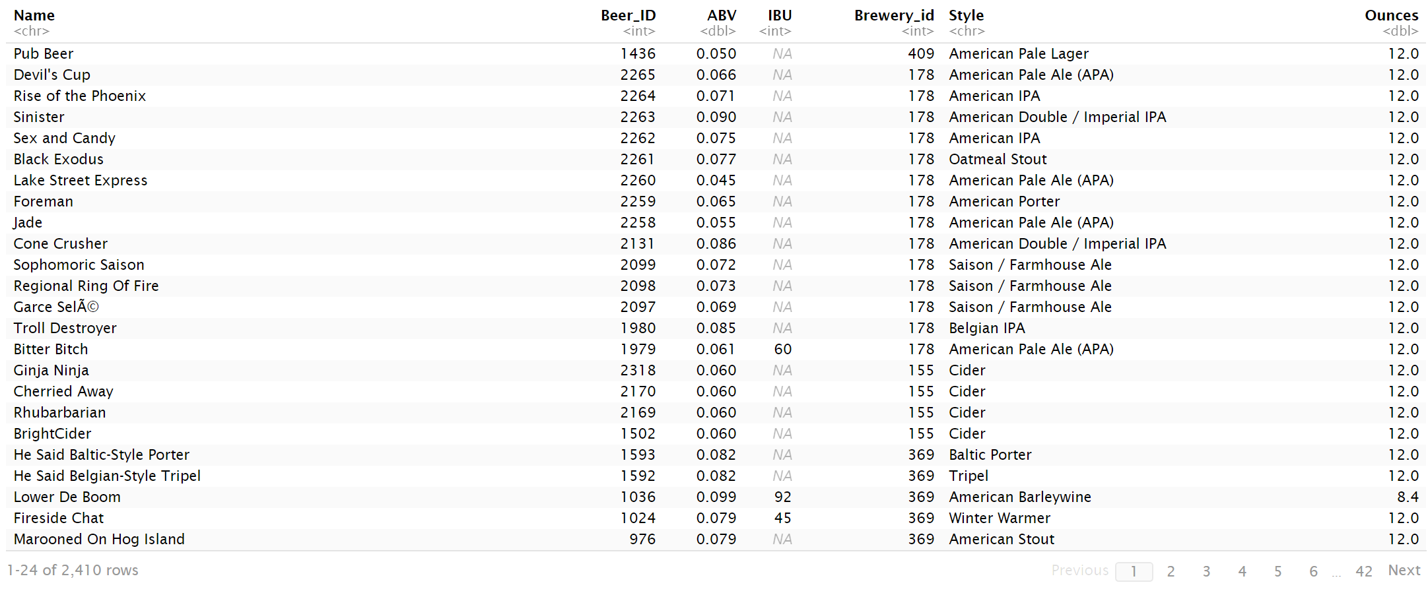
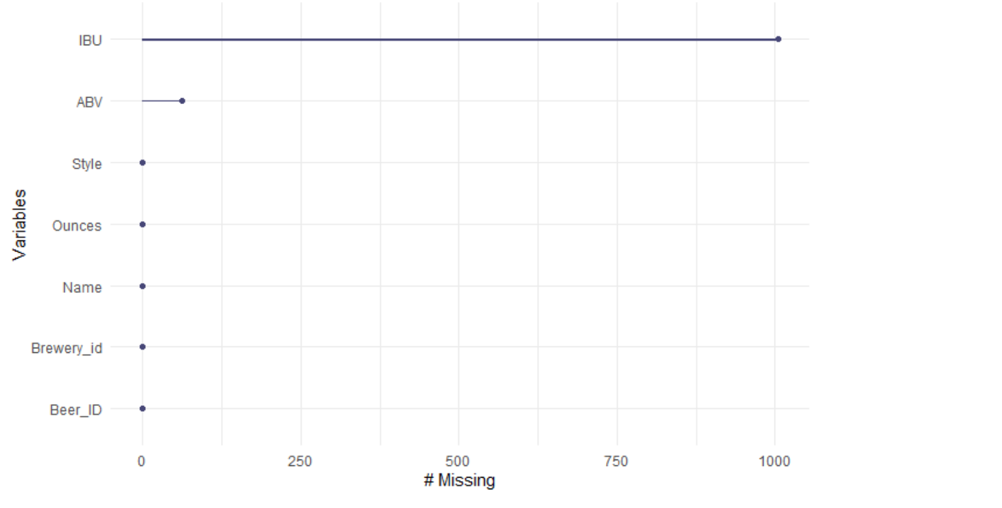
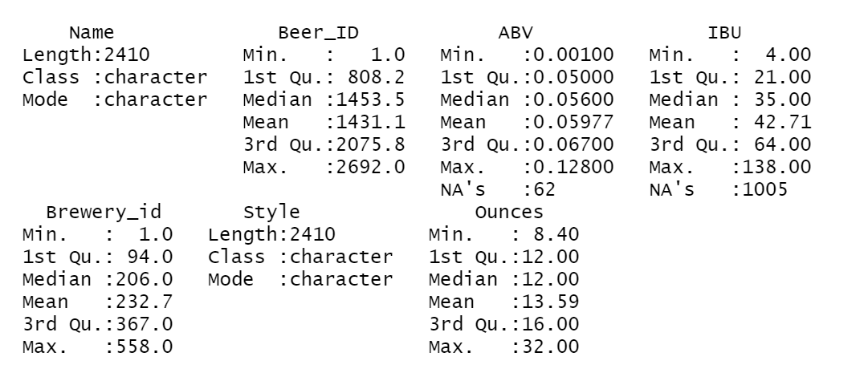
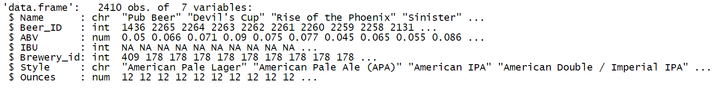
Beer Summary
Beer dataset has 2410 records with 7 variables providing more information on the different Craft Beers
Find below the missing data in the dataset
ABV – 62 missing data
IBU – 1005 missing data
The variable summary and the variable types of the original data set has been provided for reference
Used gg_miss_var to find the missing records

Slide 5
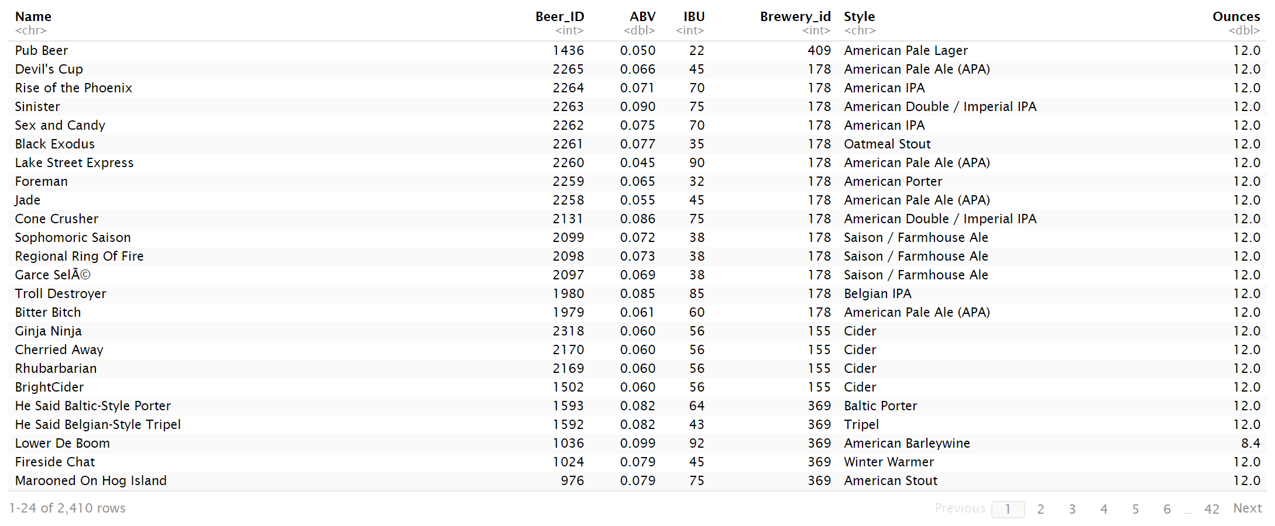
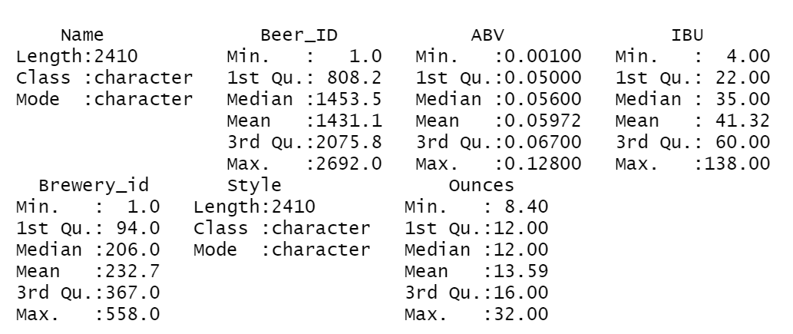
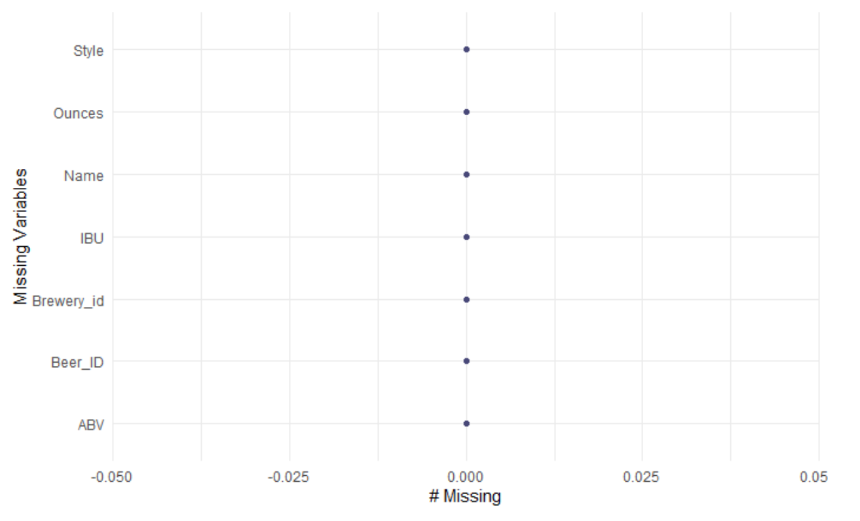
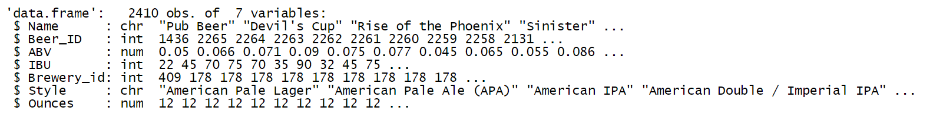
EDA : Beer Summary
Researched the internet for missing data and were able to fill the ABV and IBU observations
Searched with the below:
Beer Name
Beer Style
Ounces
Populated the missing data:
ABV – 62 missing data
IBU – 1005 missing data

Slide 6
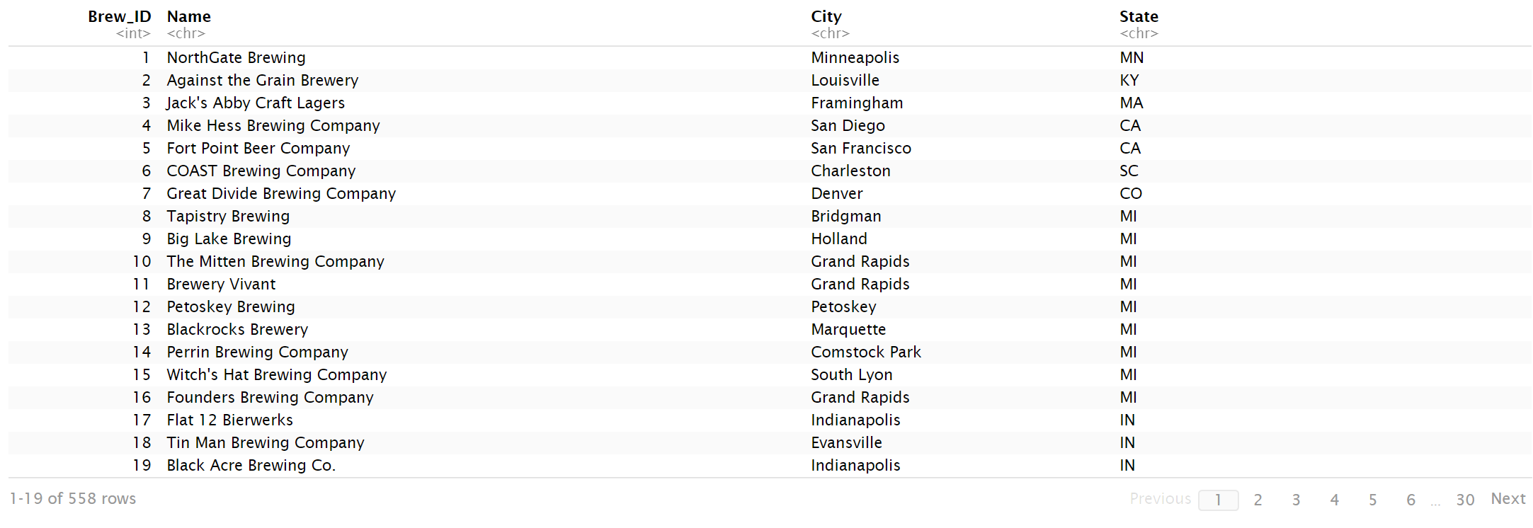
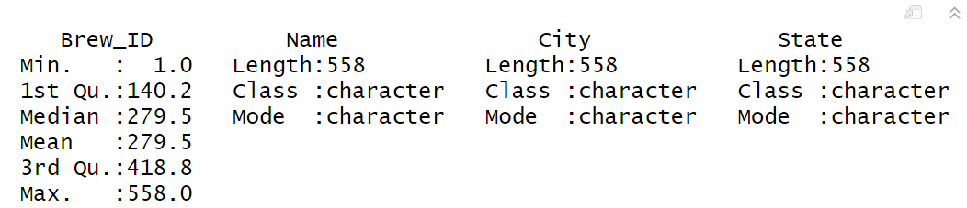
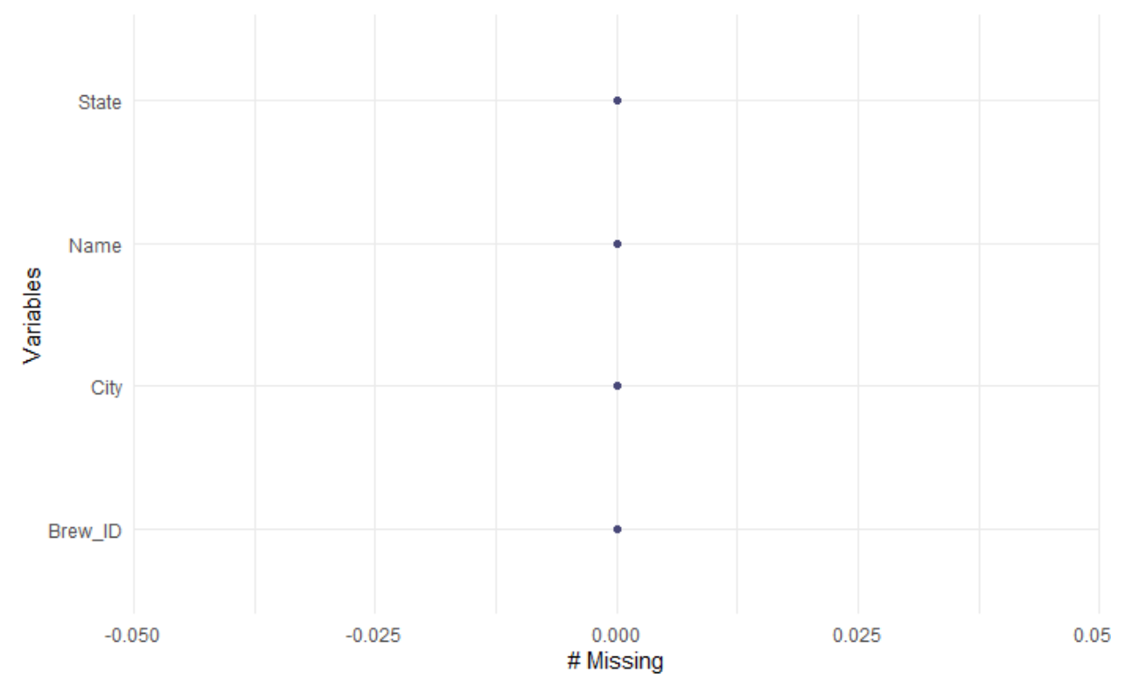
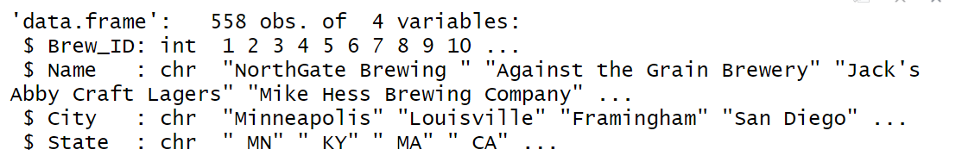
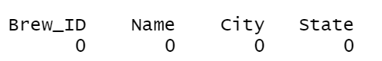
Breweries Summary
Brewery dataset has 558 records with 4 variables providing more information on the different Breweries across the states of US
Initial Analysis shows that the State data has white spaces on the left

Slide 7
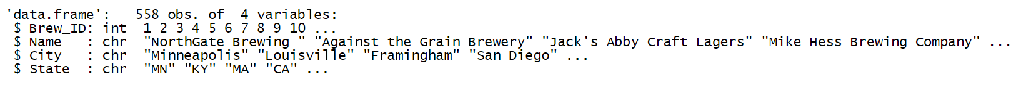
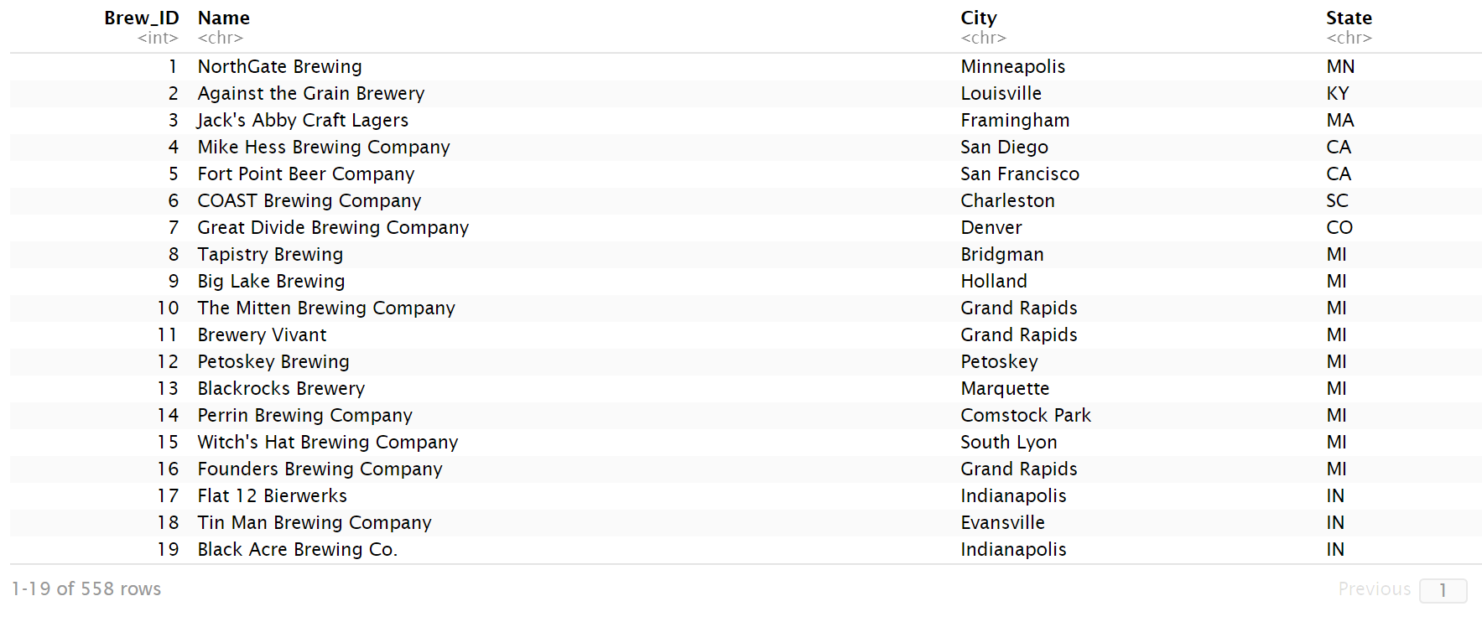
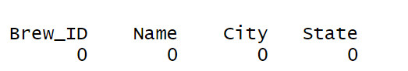
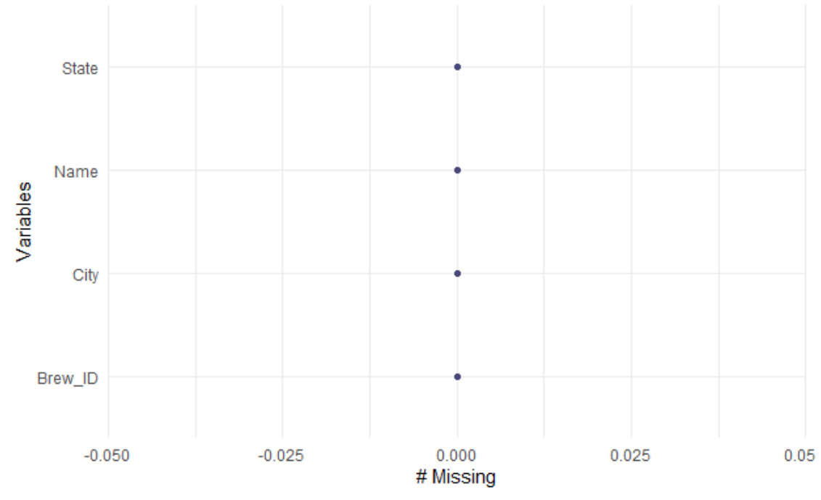
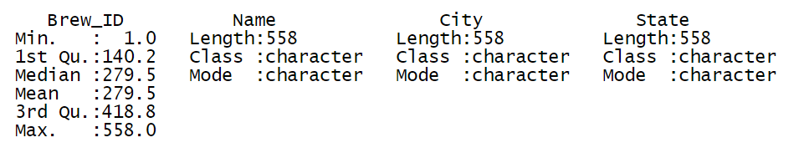
EDA: Breweries Summary
Used str_trim function to replace the whitespaces
The dataset is ready to be merged with any dataset

Slide 8
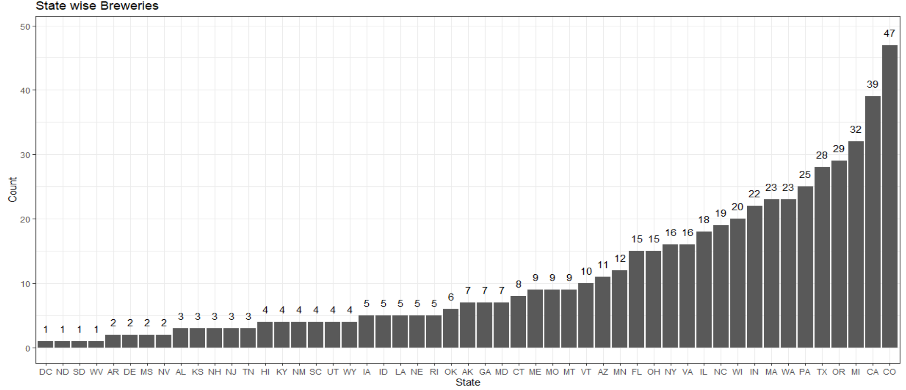
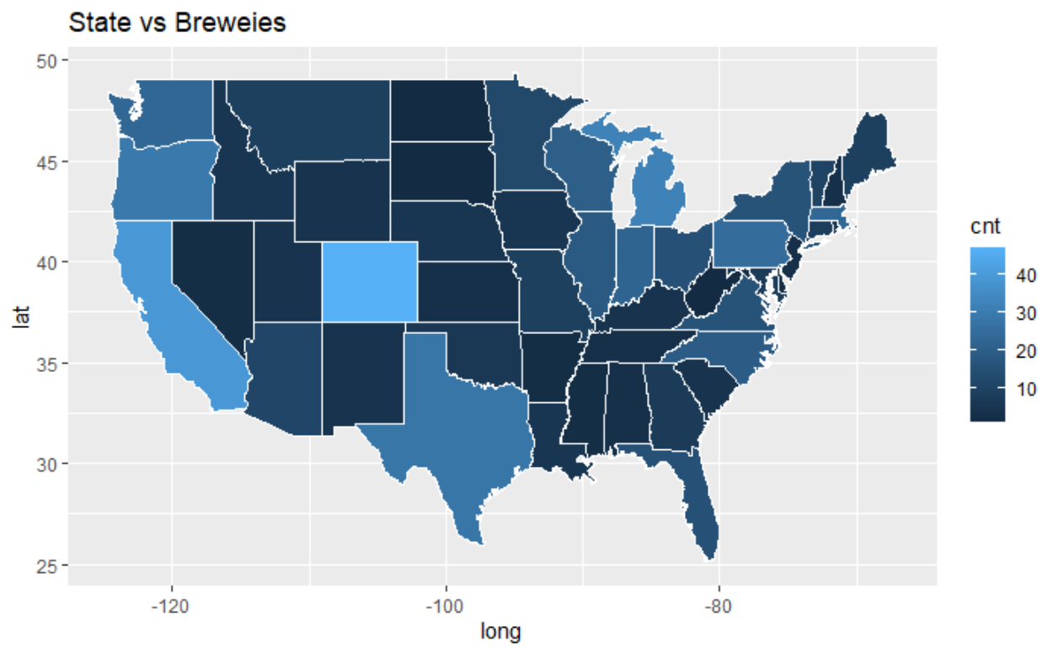
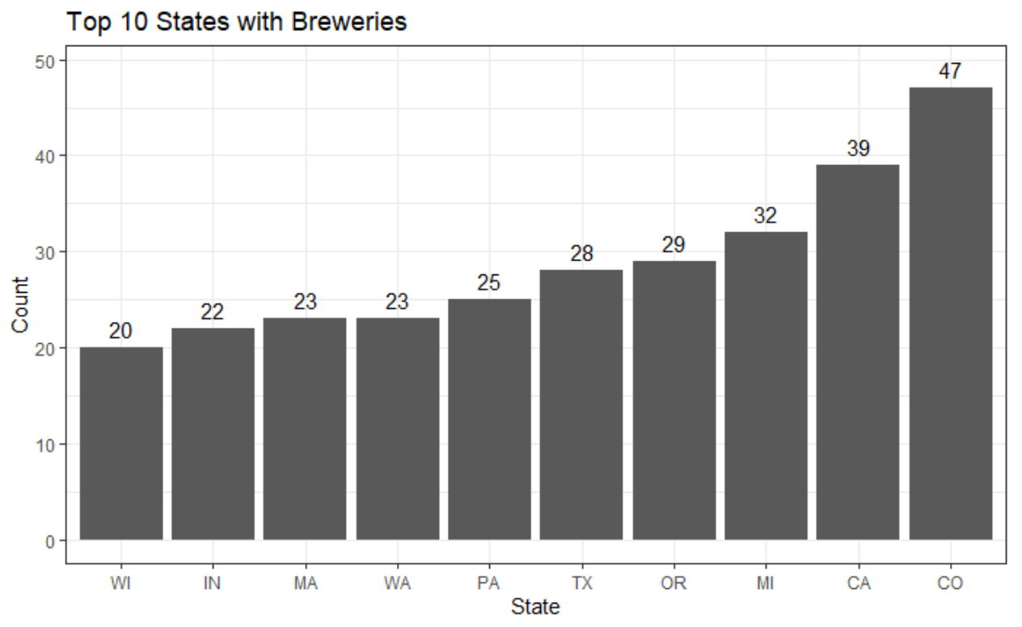
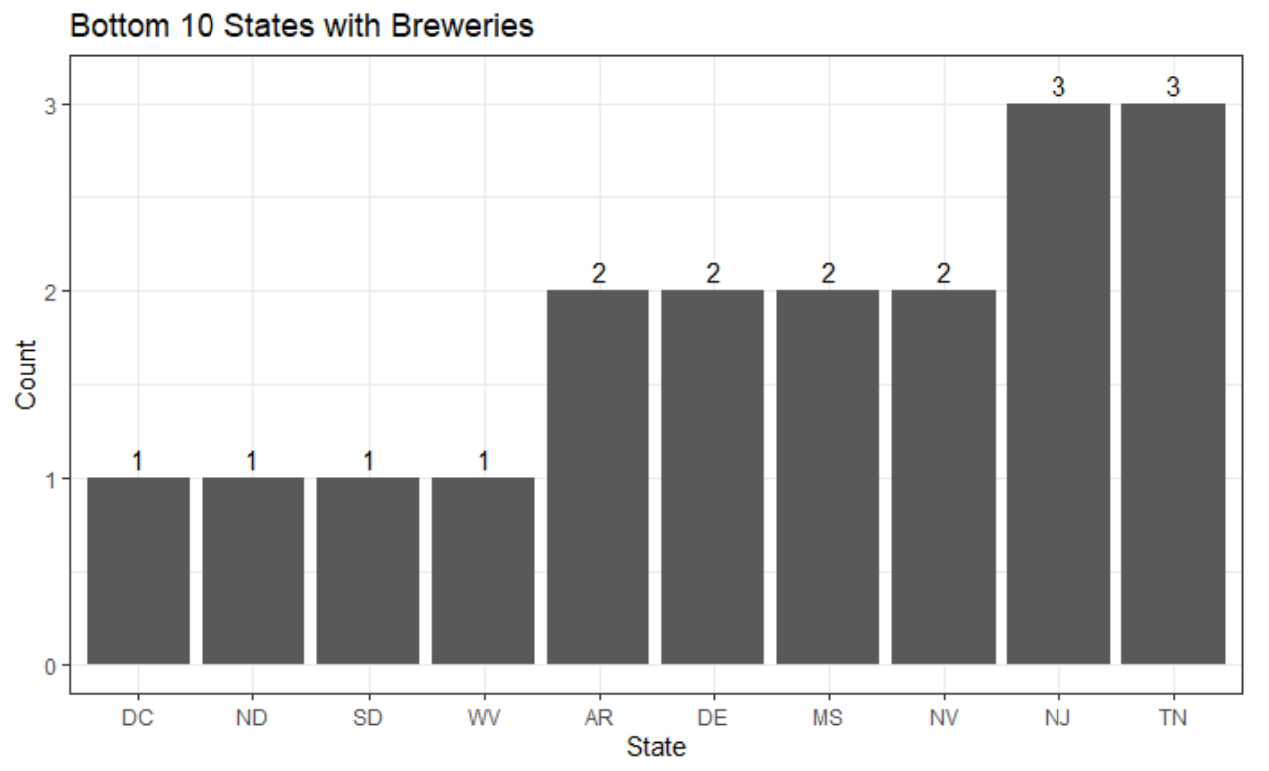
Breweries by State
How many breweries are present in each state?
Colorado is the state with the largest number of breweries
California, Michigan, Oregon, Texas and Pennsylvania are the states with the next largest breweries after Colorado
West Virginia, South Dakota, North Dakota, Nevada and DC are the states with the least breweries

Slide 9
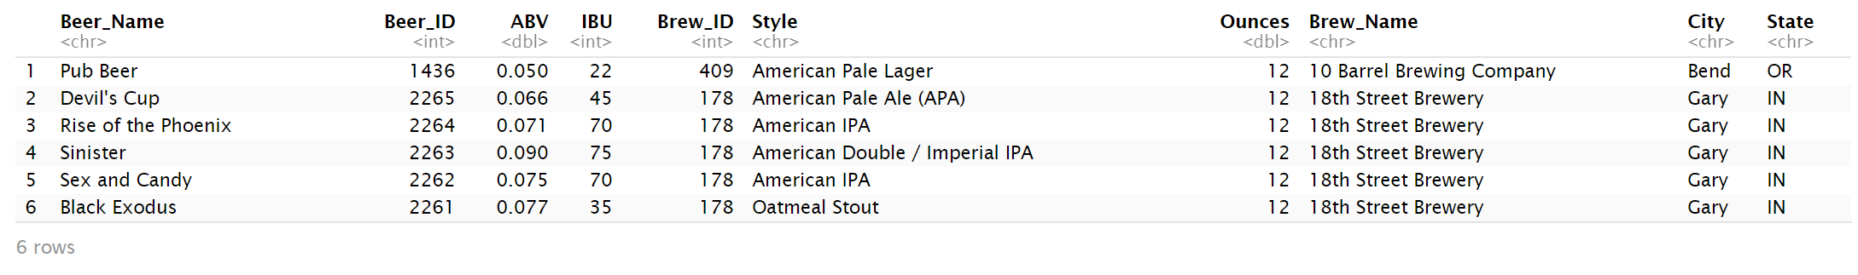
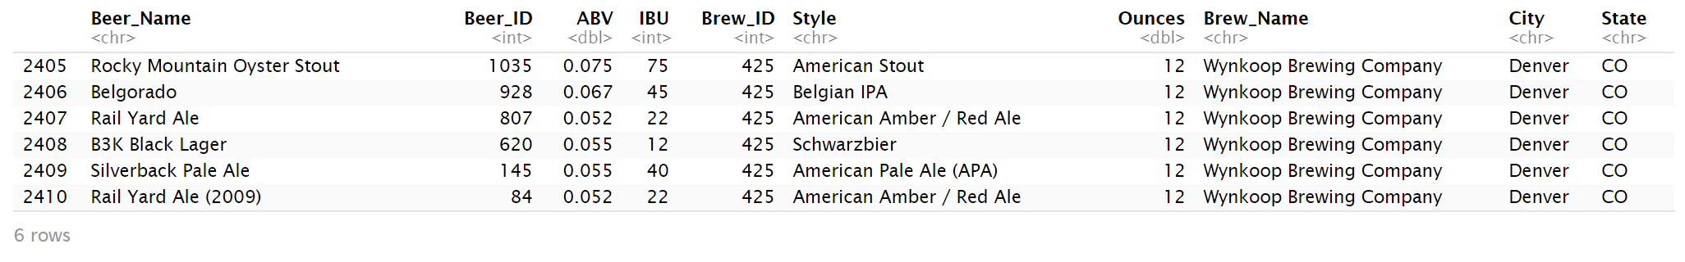
EDA: Merge the Dataset
Top06 records
Print the first 6 observations and the last six observations to check the merged file
Merged Beers and Breweries Dataset on Brew_ID
Renamed column Brewery_ID to be in sync with the Brewery dataset
Updated column name on both Beer and Brewery dataset to Brew_Name and Beer_Name to ensure we have unique columns
Bottom06 records

Slide 10
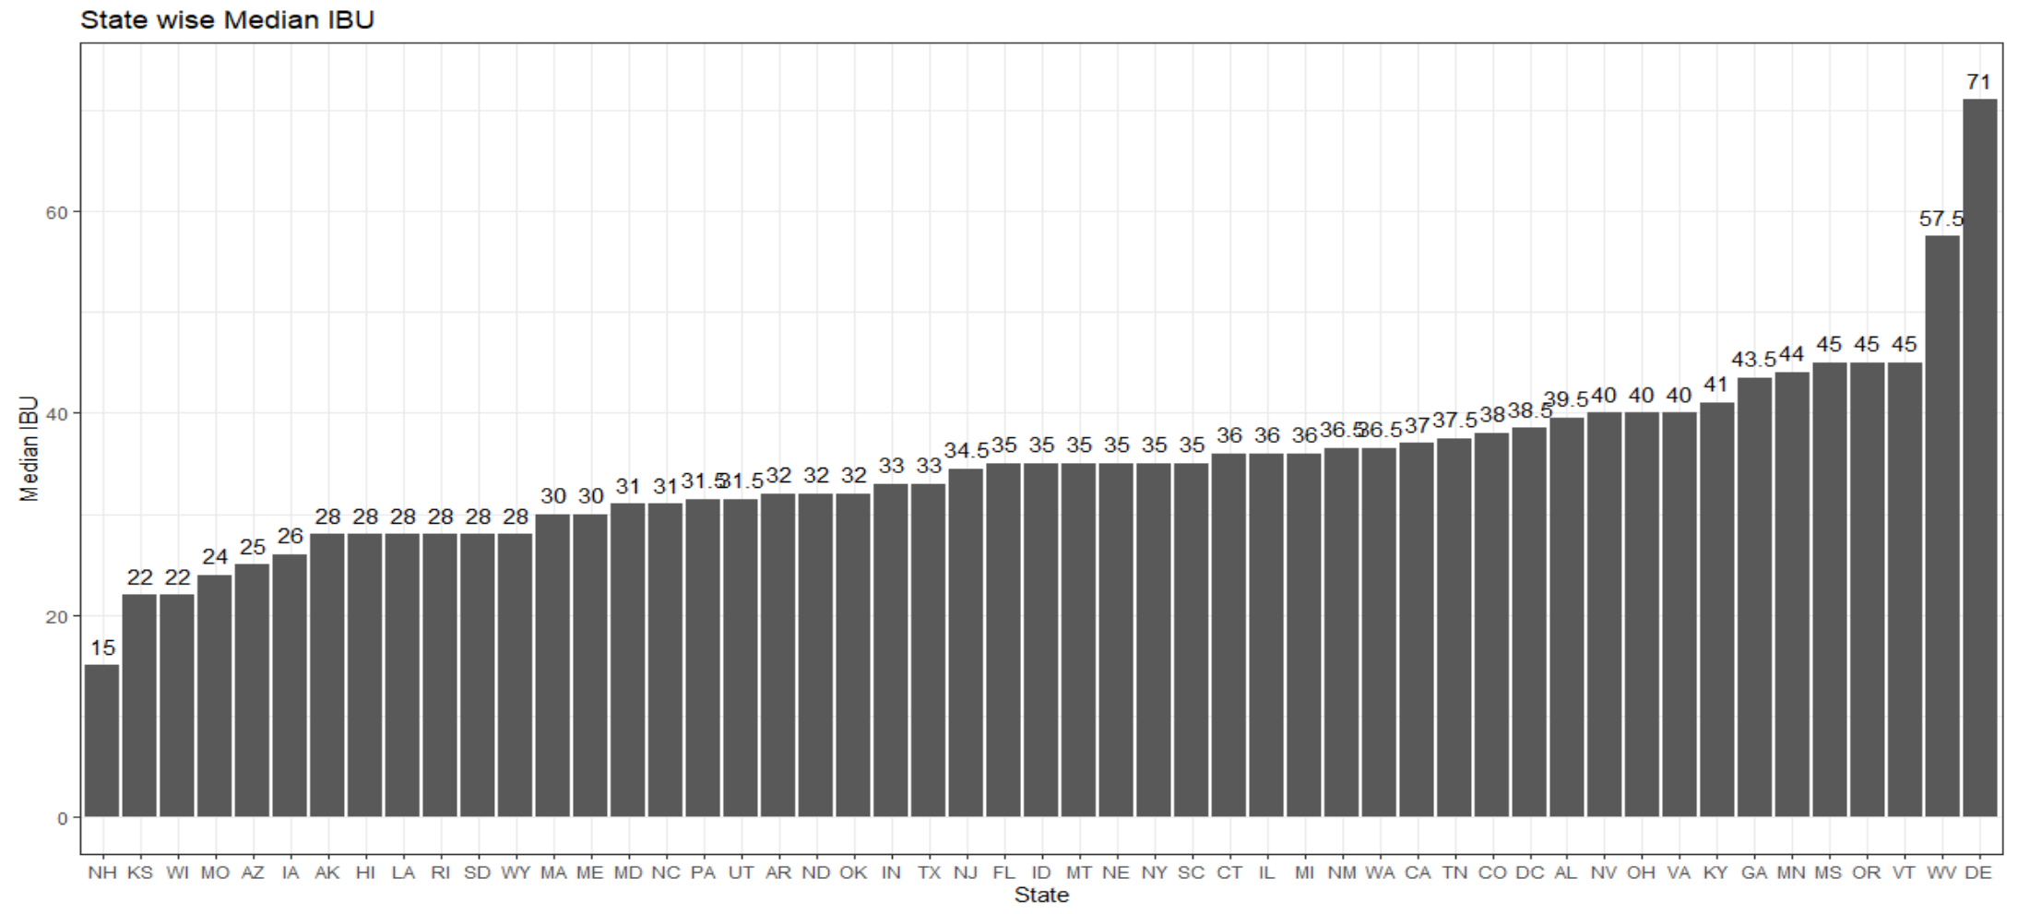
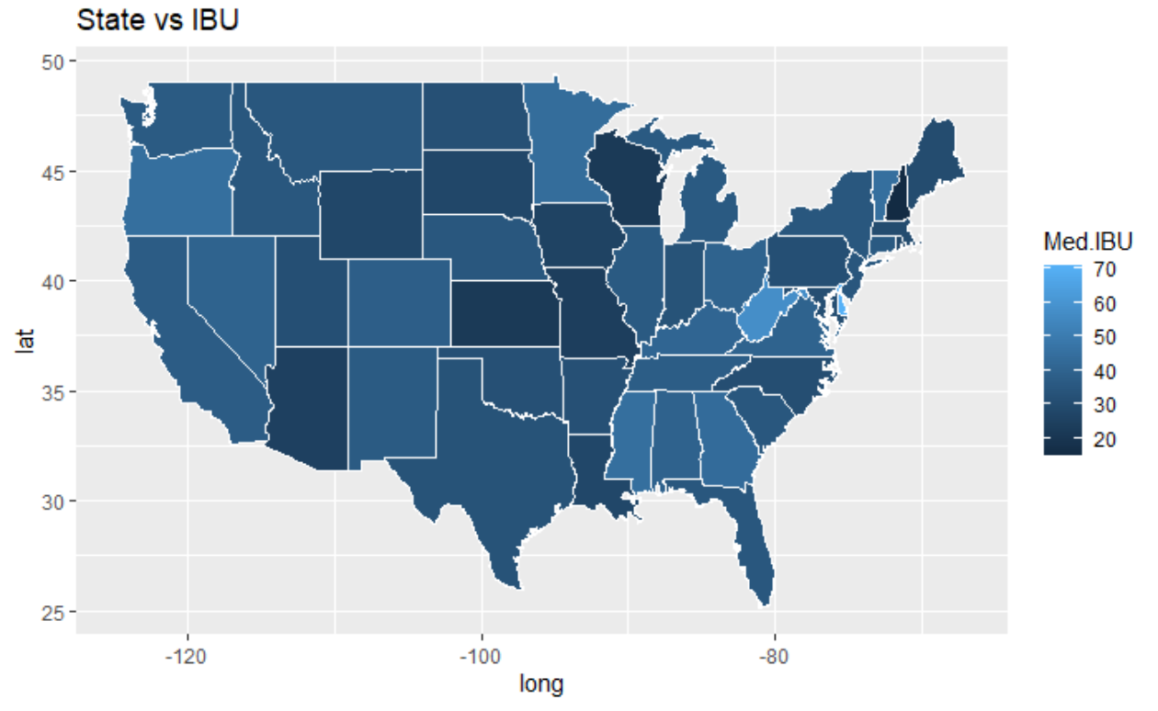
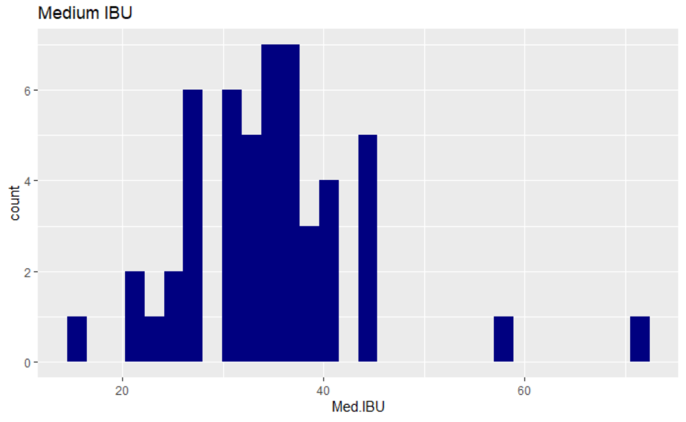
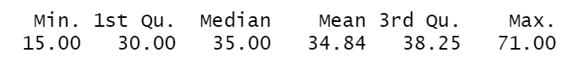
IBU & ABV per State
Median IBU per State
Compute the median IBU and ABV and Which state has the maximum ABV and IBU beer
Delaware is the state with highest median IBU of 71 and West Virginia with median IBU of 57.5
New Hampshire is the state with the least median IBU of 15
Summary of IBU

Slide 11
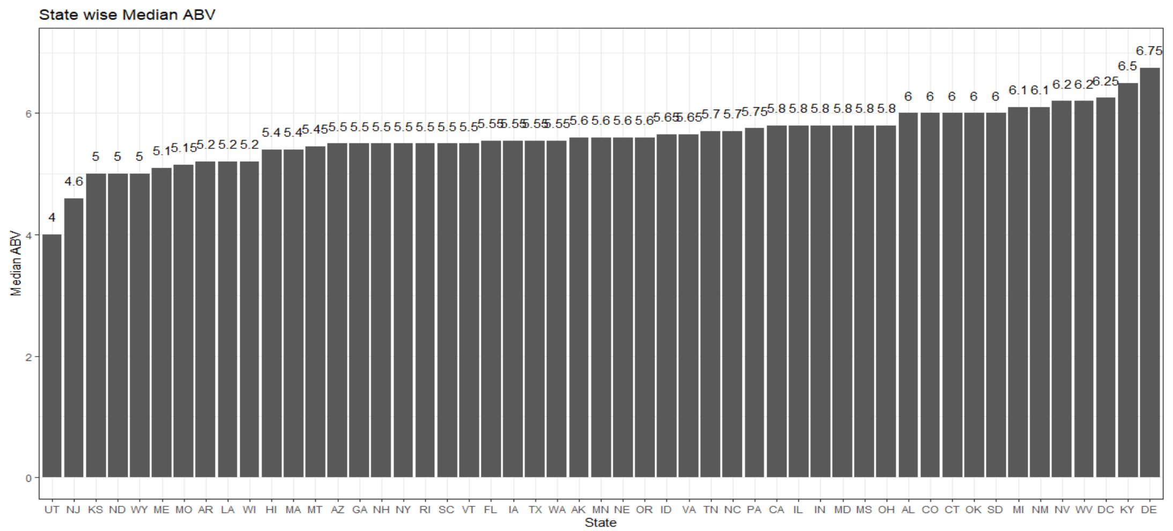
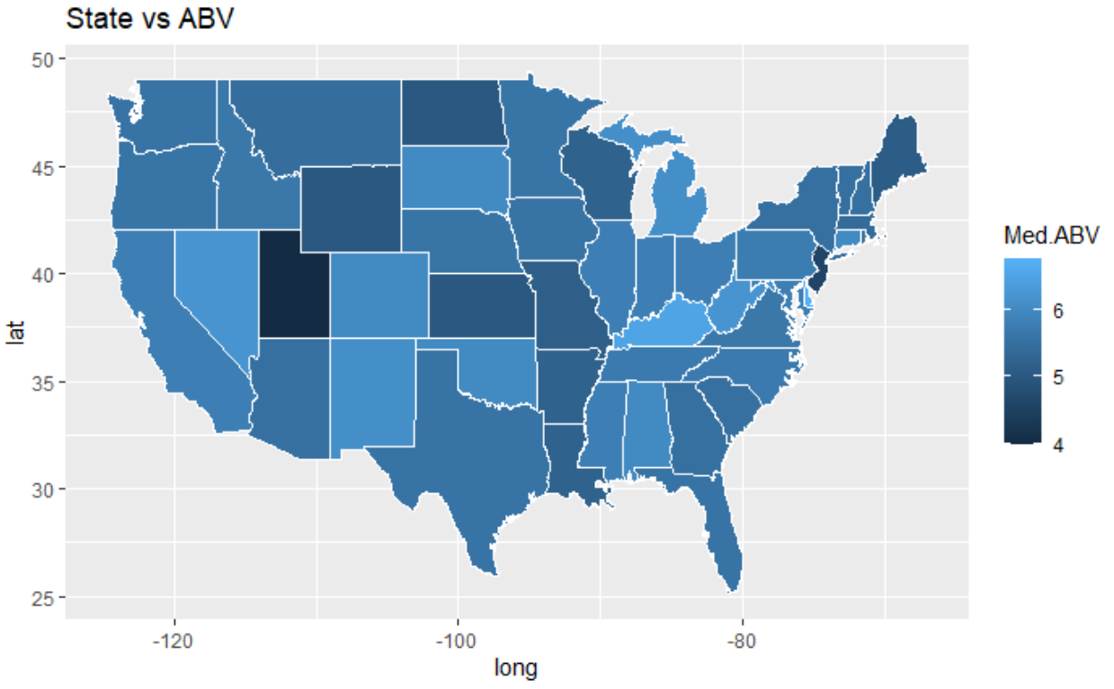
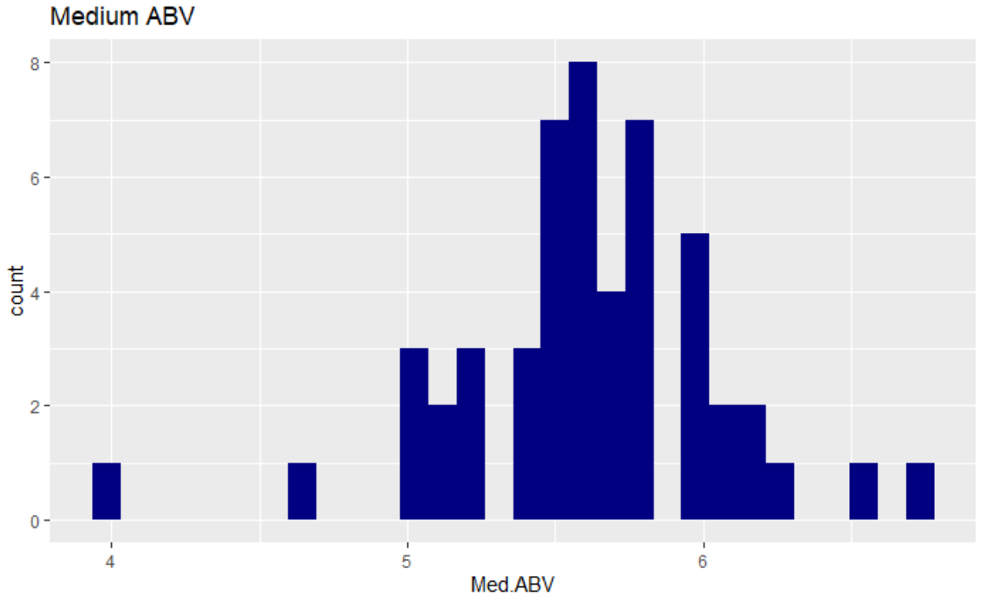
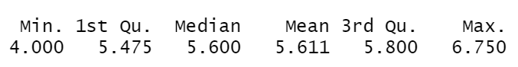
IBU & ABV per State
Median ABV Per State
Delaware is the largest state with median ABV of 6.75
Kentucky is the next largest state with median ABV of 6.5
Utah and New Jersey are the least states with median ABV of 4 and 4.6 respectively
Summary of ABV:

Slide 12
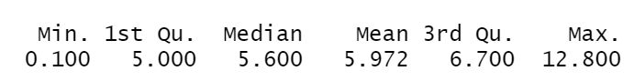
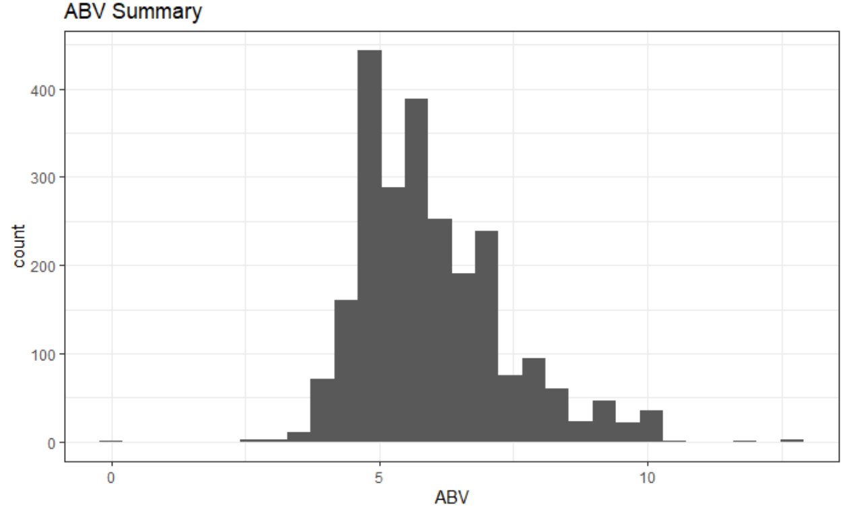
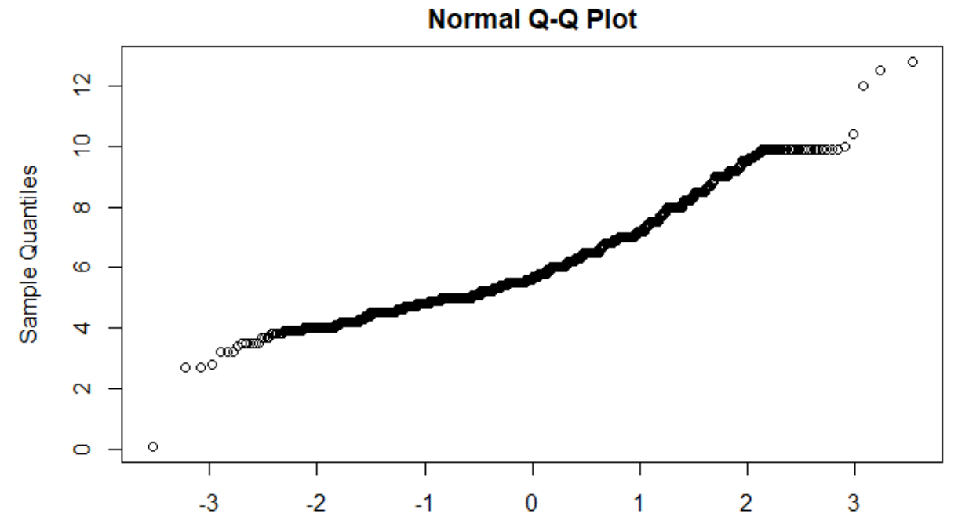
ABV Summary Stats
Summary Stats of ABV
Summary statistics and distribution of the ABV
Histogram shows that ABV data is normally distributed.
QQ plot shows that the data has constant variance
Mean ABV is 7.972 and the median ABV is 5.600
Min ABV is .1 and Max ABV is 12.8

Slide 13
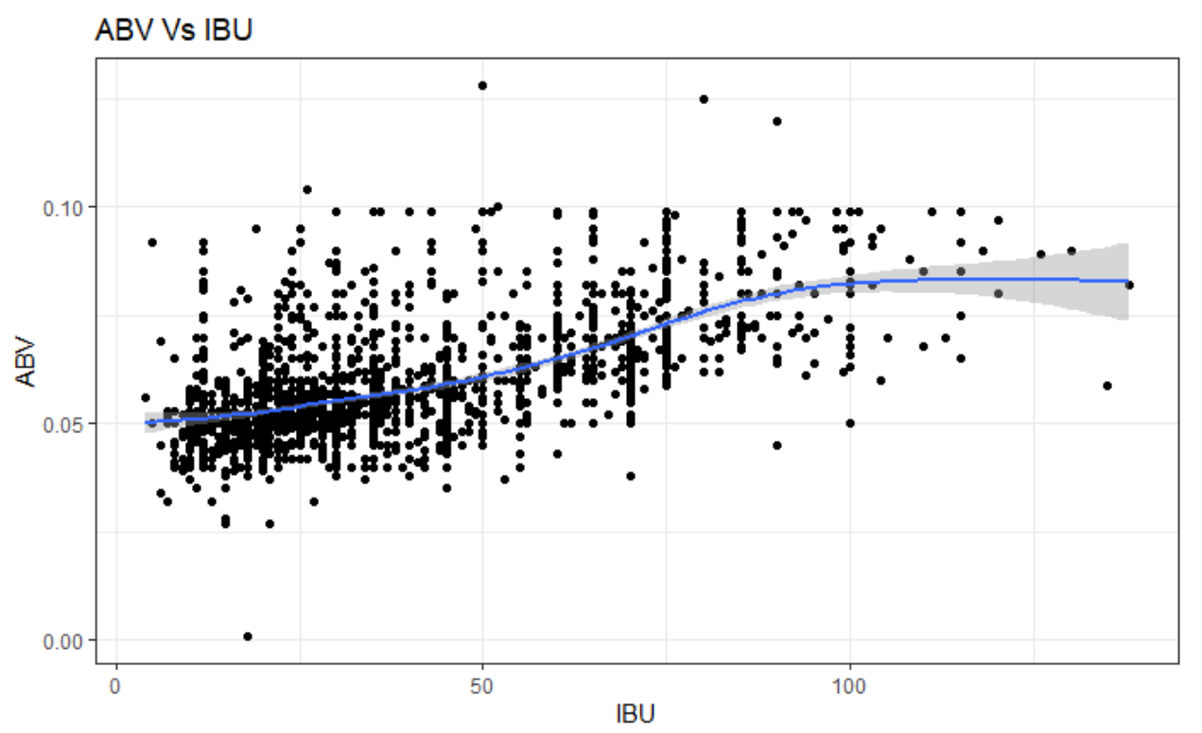
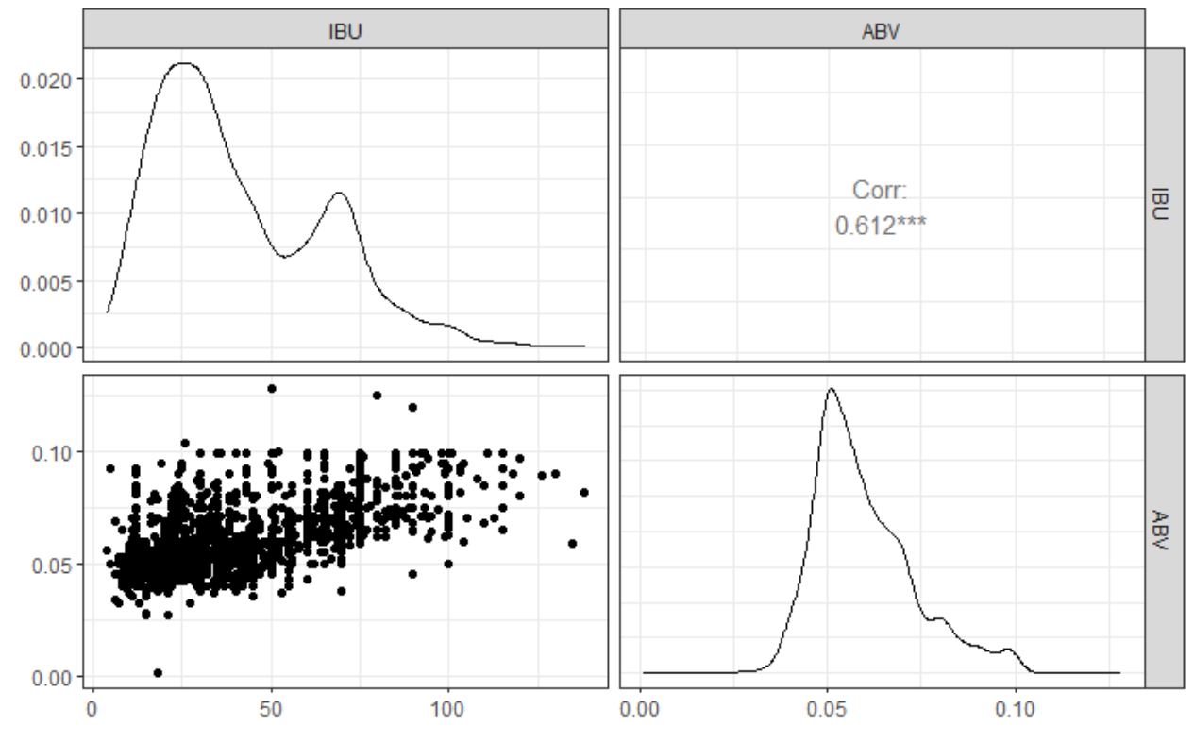
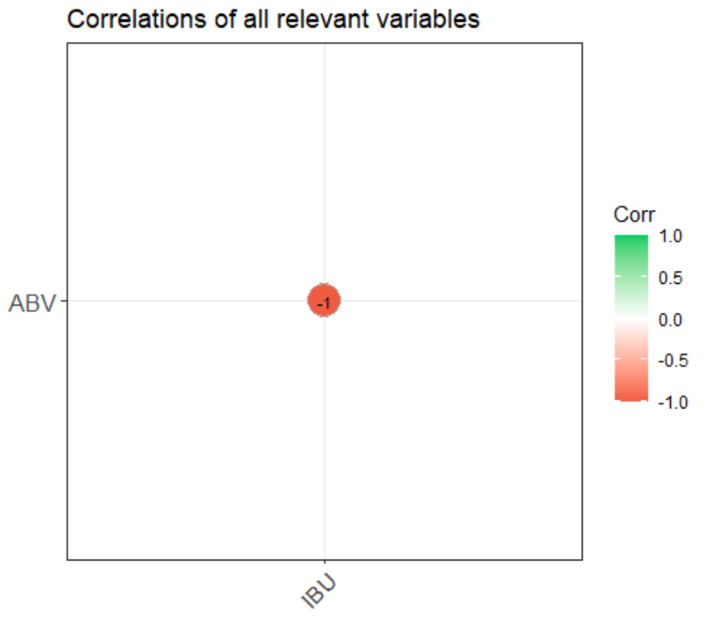
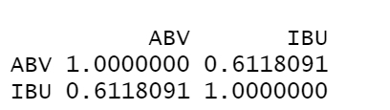
IBU Vs ABV
Is there an apparent relationship between the bitterness of the beer and its alcoholic content?
There is a positive linear relationship with ABV and IBU
For every 1 unit increase in ABV there is an increase in the IBU
IBU and ABV is highly positively correlated which is helpful in predicting the future observations or any missing observations
It is observed that the data is slightly skewed but using the Central limit theorem with the provided dataset there is not enough evidence to suggest IBU and ABV is not normally distributed
Scatter plot shows even spread which does not provide enough evidence to suggest that the data does not have a constant variance

Slide 14
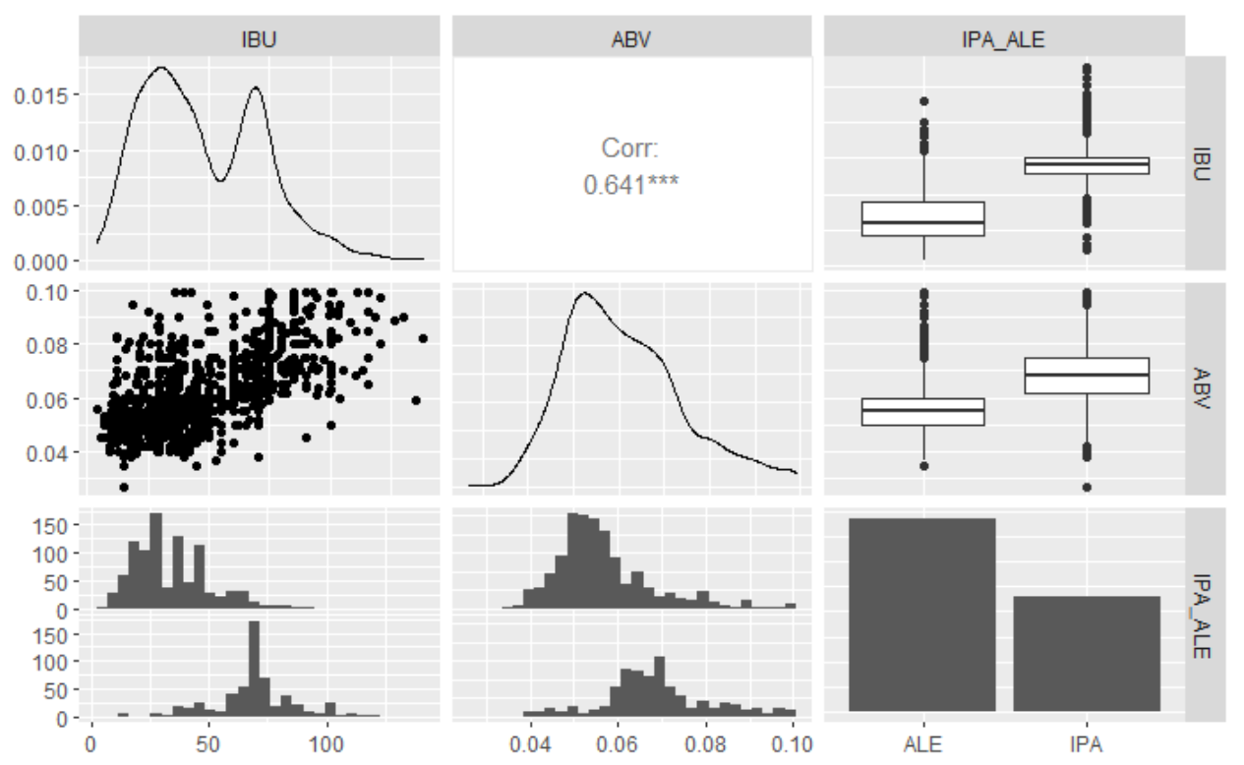
K Nearest Neighbors (k-NN)
KNN classification to investigate the relationship between ABV and IBU
Extrapolated a new variable IPA_ALE which segregates all beers with style IPA to IPA and the rest of the Ale s to ALE
Initial Analysis show that IBU and ABV between IPA and ALE is linearly correlated
There is an interaction between IPA and ALE beers
IPA seems to have a greater IBU and ABV compared to ALE
The assumption of normal distribution and constant variance is satisfied
The observations are considered to be independent

Slide 15
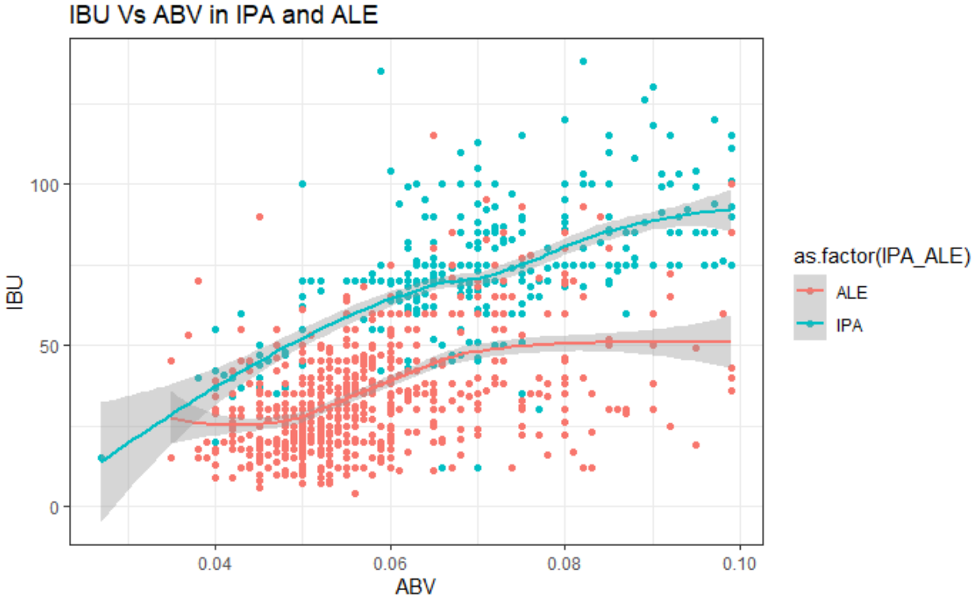
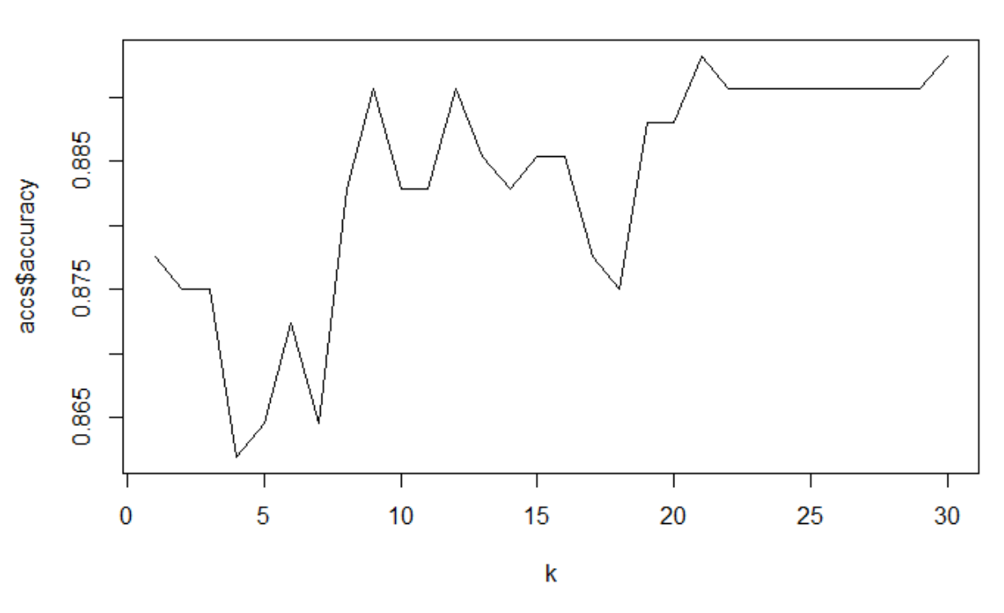
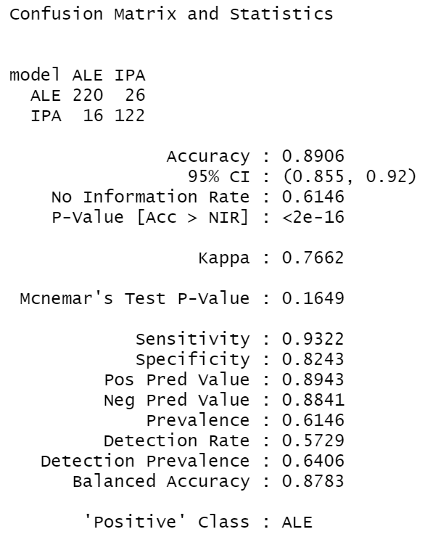
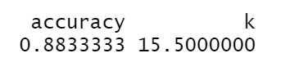

K Nearest Neighbors (k-NN)
K-NN classification is used to predict a beer type based on IBU and ABV
Our strategy is to find the closest styles and let the majority rule on whether the beer type will be IPA or ALE
ALE Vs IPA data has been plotted on the scatter plot
The best value of k = 22 and accuracy = .8906
ALE is been the majority with the prediction accuracy of 0.8833 and when k=15.5

Slide 16
Naïve Bayes (NB)
Extrapolated a new variable IPA_ALE which segregates all beers with style IPA to IPA and the rest of the Ale s to ALE
Initial Analysis show that IBU and ABV between IPA and ALE is linearly correlated
There is an interaction between IPA and ALE beers
IPA seems to have a greater IBU and ABV compared to ALE
The assumption of normal distribution and constant variance is satisfied
The observations is considered to be independent

Slide 17



Naïve Bayes (NB)
NB classification is used to predict a beer style based on IBU and ABV
Our strategy is to predict the beer style based on ABV or IBV
ALE Vs IPA data has been plotted on the scatter plot
Accuracy is .8828
Positive Class is ALE

Slide 18







Conclusion
Across the states of US : ALE brewed more than IPA in major breweries
Volume brewed : ALE > IPA
12 ounce is brewed more than the 24 and 32 ounces. ALE is sold more than IPA in 12 ounces and IPA constitutes more than ALE in 16 ounces
Colorado & California are the major breweries that brew ALE and IPA across US
DC and Delaware are the states with the least breweries for ALE and IPA
Mean IBU : IPA = 70 and ALE = 34
Mean ABV : IPA = 6.8 and ALE = 5.6

Slide 19


Inference
As this is an observational study there is no cause and effect but association to the conclusion
We cannot conclude that IPA is more sought out beer than ALE from the mean IBU and ABV values (pvalue <0.0005 from the knn and NB test)
In conclusion the association between IBU and ABV can be generalized to identify IPA and ALE beer styles in the selected area of study in the US but cannot be generalized to other countries across the world
Though the production of ALE is more than IPA, we have enough evidence to suggest that the market for IPA is increasing and there is potential for business in the states of US
Based on the 5-year trend we have enough evidence to suggest that though the count of Breweries is less in Montana, North Dakota and South Dakota the consumption rate is the highest especially with ALE from our study.
Cited : https://www.visualcapitalist.com/united-states-of-beer/

Slide 20


Recommendation
Beer is the most popular alcoholic beverage in US, though the demand is not spread equally
Utah has a low level of beer consumption for a couple of reasons. Despite these barriers, Utah’s beer consumption has grown by 2.8% which is a great potential for a new market
New Hampshire is another outlier. The state has no sales tax. It is estimated that over 50% of the state’s alcohol sales are to out-of-state visitors and is a great potential for new ALE business
Oregon has been at the forefront of the craft beer revolution sweeping the country. Portland alone has over 100 craft brewers, and nearly double-digit growth in the past five years. In states like Oregon and Washington, demand shows no sign of slowing down and is a great market to introduce new flavors especially ALE
Montana, South Dakota and North Dakota are few states with less breweries but whose consumption is the most and is a great potential for new market
Cited : https://www.visualcapitalist.com/united-states-of-beer/

Slide 21
Questions ?

Slide 22
Thank You!

